Slide 1

Getting Started with the
A
B
LEDS
C
D
K1
K18

Slide 2
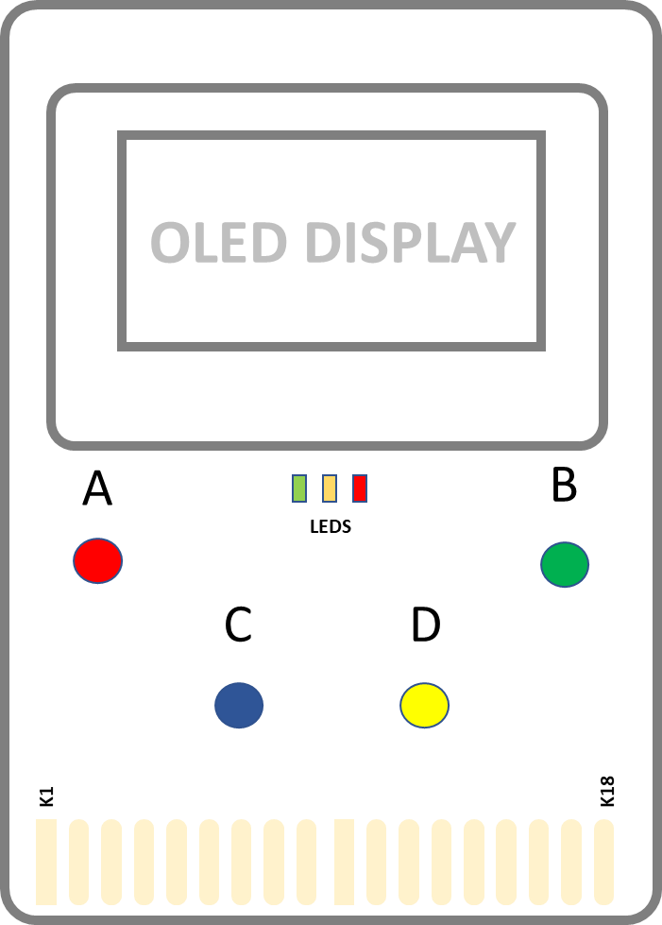
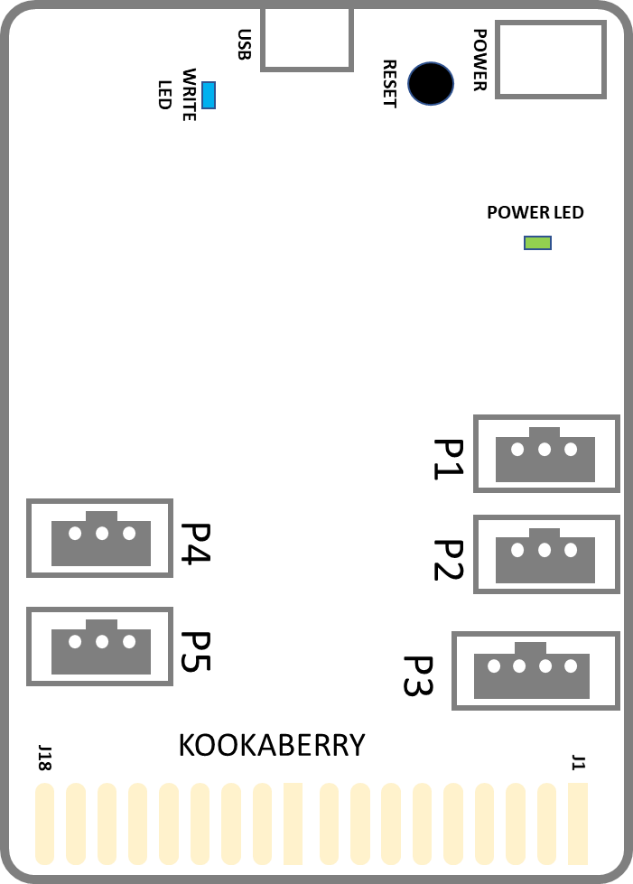
Features
FRONT
Monochrome OLED Display (128 pixels wide x 64 high)
Green, Amber, Red LEDs
Buttons A, B, C and D
Expansion Connector
BACK
Micro USB Connector (power and programming)
Reset button (restart)
Battery box connector (power only)
Green LED (power is on)
Blue LED (storing data)
Accessory connectors
3 pin P1, P2, P4, P5
4 pin P3
Expansion Connector
5 VOLT USB
BATTERY

Slide 3
Power Up
USB CABLE
A
B
5 VOLT USB
BATTERY
C
D
KOOKABERRY

Slide 4

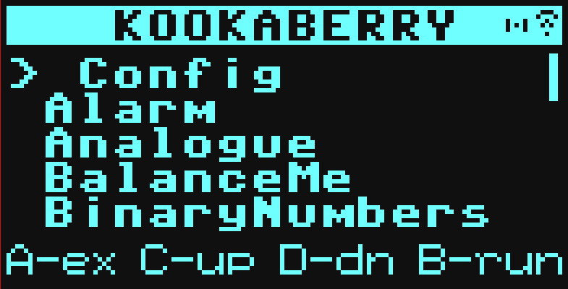
Start Up
Hold Button B and
Click the Reset Button
Release Button B
The built-in Kookaberry menu should appear on the display
Buttons C and D to select
Button B to run
Button A to exit
5 VOLT USB
BATTERY

Slide 5

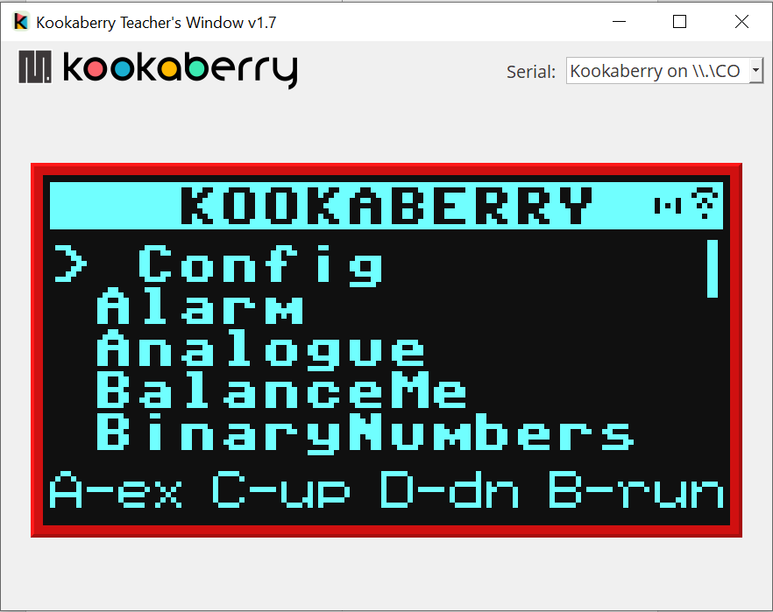

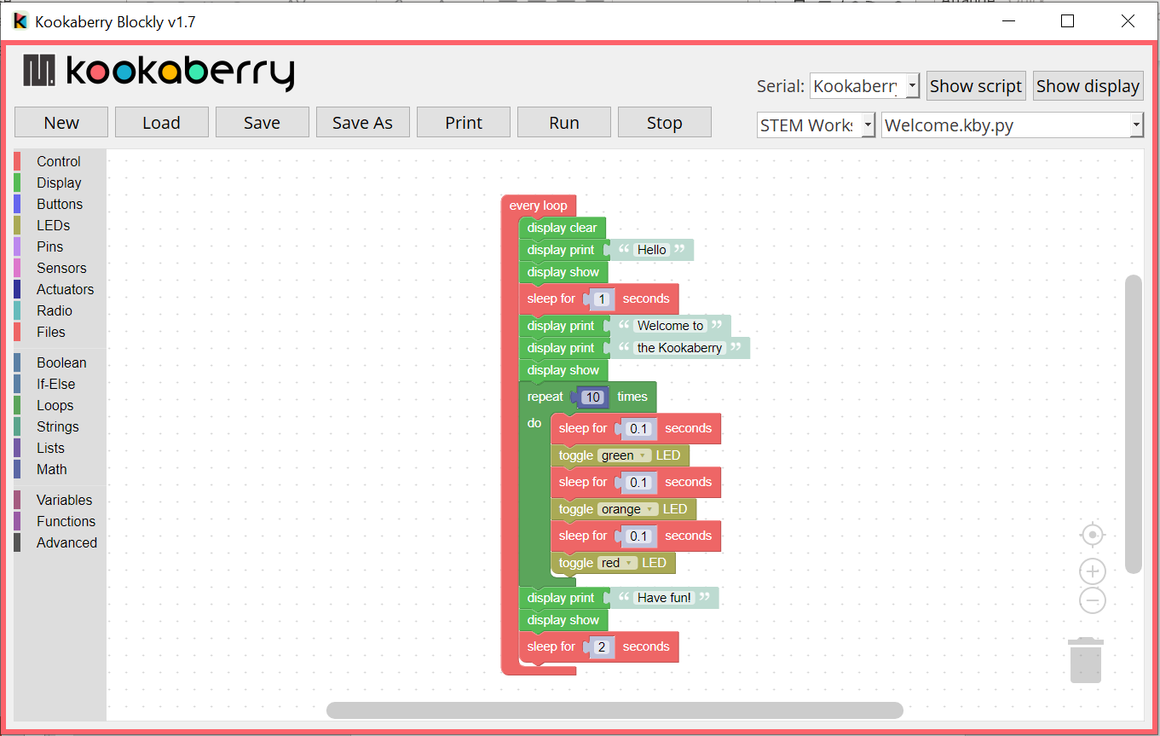

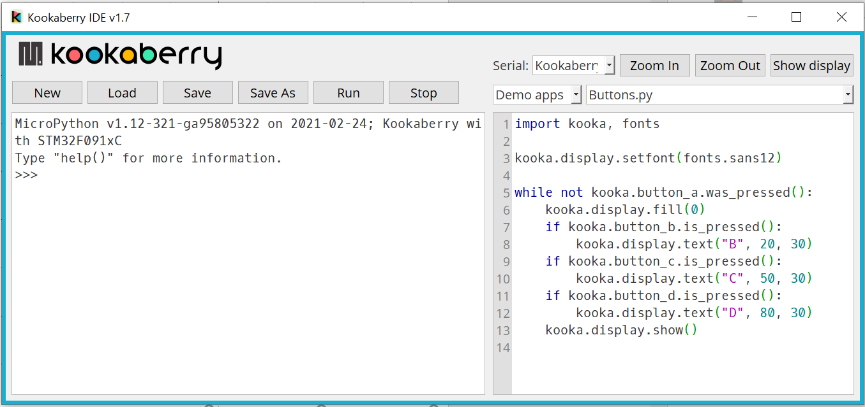

Coding Tools
Duplicates the Kookaberry Display on your computer
Visual coding for the Kookaberry
5 VOLT USB
BATTERY
Python coding for the Kookaberry
For Windows, Macintosh and Raspberry Pi
Download from:
Kookaberry.net.au/kookasuite

Slide 6

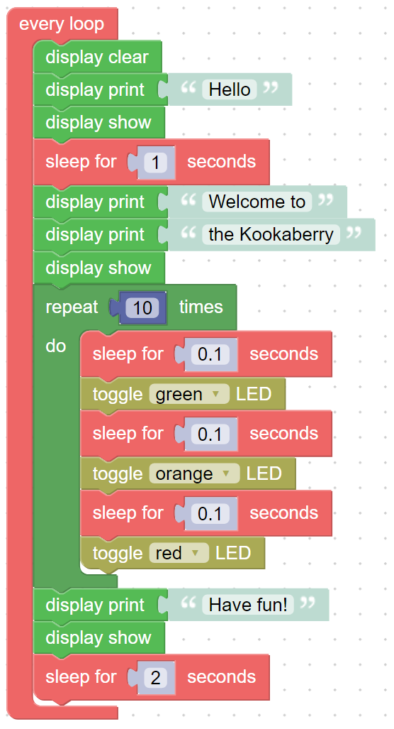
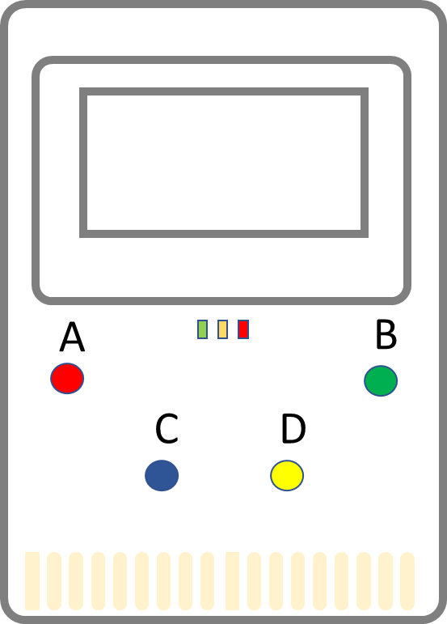
Connect and Code
USB CABLE
5 VOLT USB
BATTERY
KOOKABERRY
Kookaberry.net.au/coding

